Slide 1
SMOOTH OPERATOR:
How to Be a Safe Driver Around Pedestrians and Bicyclists
For Municipal Drivers
Amy Watkins, MPH
Watch for Me CT Program Coordinator

Slide 2
Watch For Me CT
Watch for Me CT is a comprehensive program aimed at reducing the number of injuries and fatalities as a result of traffic crashes involving pedestrians and bicyclists in Connecticut.
Notes:
As we head into the fall, it is a good time to talk about being mindful of the hazards associated with sharing the roads with bicyclists and pedestrians, especially when driving heavy trucks. The number of crashes increases in the fall, in part due to shorter days.
Driving requires your complete attention to keep everyone safe. As drivers we are usually on the lookout for other vehicles and are often surprised by their movements. Pedestrians and bicyclists can be even more unpredictable and we need to be prepared and watch for them. It’s up to you to look out and take early action to avoid conflicts.
Although pedestrian safety should be a two-way responsibility between driver and pedestrian, the driver is usually responsible for any consequences. Don’t let a crash ruin your day.

Slide 3
In Connecticut
In Connecticut, around 1,500 pedestrians and 550 bicyclists are hit by cars each year.
Of those, about 60 pedestrians and 5 bicyclists die due to their injuries.
Notes:
67 in 2018
Hartford 10 Danbury 5 Bridgeport 5 New Britain 4 Waterbury 3 New Haven 3 Hamden 3 Stamford 2 Windsor 2 W Locks 2 Glastonbury 2 West Haven 2 North Haven 2 Newington 2 Bristol 2 Wallingford 2 highway 8

Slide 4
Quiz Show: Testing Your Knowledge
Q: What is the most dangerous time of the day for pedestrians?
A: Most crashes involving pedestrians happen between 3 and 7 p.m., with the peak at 6 p.m. This corresponds with evening rush hour when traffic is heavier. In late fall and early winter, rush hour occurs at dusk when lighting is low.
Q: Who is more likely to be killed as a pedestrian: men or women, older or younger people?
A: Men have a much higher probability than women of being killed in a crash. They are also more likely to be the drivers behind the wheel in pedestrian crashes (52% of the time).
The most vulnerable of our population, the oldest and youngest, are most often affected. Pedestrian victims are most likely to be between 0-15 and over 64.
Q: What impact does lighting play?
A: Pedestrians are more likely to be killed in a crash in dark conditions than in lighter ones.
Q: When do most bicycling crashes occur?
A: Nearly half of all crashes involving bicycles occur in the summer months, between June and September.

Slide 5
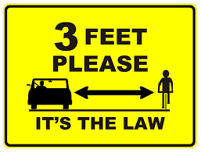
Not My Bumper: Driving Safely Near Pedestrians and Bicyclists
So how can we reduce the chance we will be involved in a conflict with a pedestrian or bicyclist?
First, know the laws:
A crosswalk does not have to be painted to be a crosswalk. A crosswalk is the continuation of the sidewalk/curb across the roadway to the other side.
3-foot passing law: Keep at least 3 feet between you and a bicyclist or pedestrian. It is legal to cross the double yellow line to pass if there is no oncoming traffic and it is safe to do so.
Bicyclists may be in the lane! Bicyclists traveling on roadways have the same rights and responsibilities as motorists.
Notes:
The 3-foot law protects YOU – you never know what might cause someone to move into your lane suddenly. Take yourself out of the equation by staying at a safe distance, so no matter what they do, YOU can continue on with no incident.

Slide 6
Driving Safely Near Pedestrians and Bicyclists
There are things you can do to reduce the chance of being involved in a crash:
Prepare yourself
Anticipate hazards
Think and look ahead
Keep your options open
Manage the risk

Slide 7
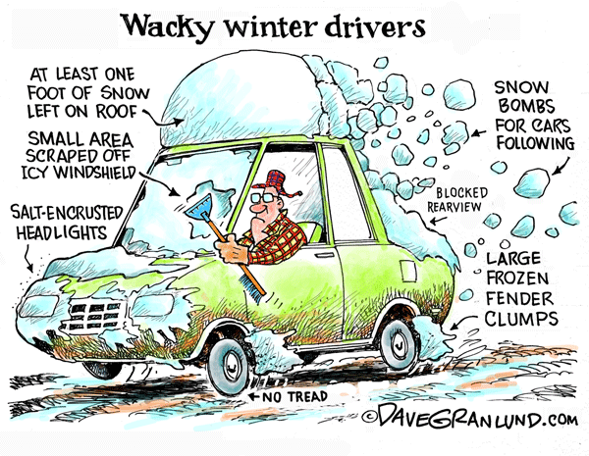
Driving Safely Near Pedestrians and Bicyclists
Prepare yourself
Be aware of factors that might impact your driving ability, such as medications, fatigue, alcohol, weather conditions, and poor lighting or visibility.
Clean your windows and turn on your headlights for better visibility during rain, snow, or foggy conditions. In snow, brush off your taillights and headlights.

Slide 8
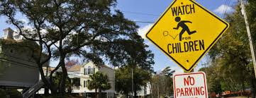
Driving Safely Near Pedestrians and Bicyclists
Anticipate hazards
Always be ready for the unexpected.
Slow down around pedestrians, bicyclists, intersections, and crosswalks. Look out for situations that require extra caution. In heavily congested areas reduce speed to give that added second to avoid striking pedestrians if they dart into the roadway.
Do not assume that you have been seen.

Slide 9
Driving Safely Near Pedestrians and Bicyclists
Think and look ahead
Keep Your Eyes Up: It's tempting to look down over the hood at the center line or at tail lights in front of you. It's much more effective to keep your eyes up and moving.
Scan Ahead: Look ahead at least 12 to 15 seconds and move your eyes from sidewalk to sidewalk. Moving your eyes is important because your peripheral vision becomes increasingly ineffective as your speed increases.
See the big Picture: By moving your eyes, you get a “big picture” perspective of the traffic environment and your place in it.
Notes:
Actively search for pedestrians, especially in urban areas where they are numerous.

Slide 10
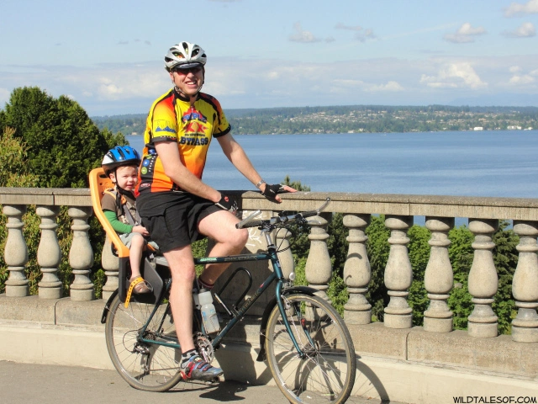
Driving Safely Near Pedestrians and Bicyclists
Keep your options open
Be aware of other vehicles around you and your options to change lanes, slow, or stop if you need to avoid someone.
If you are in any doubt about a pedestrian or bicyclists’ movements, cover the brake and reduce your speed.

Slide 11
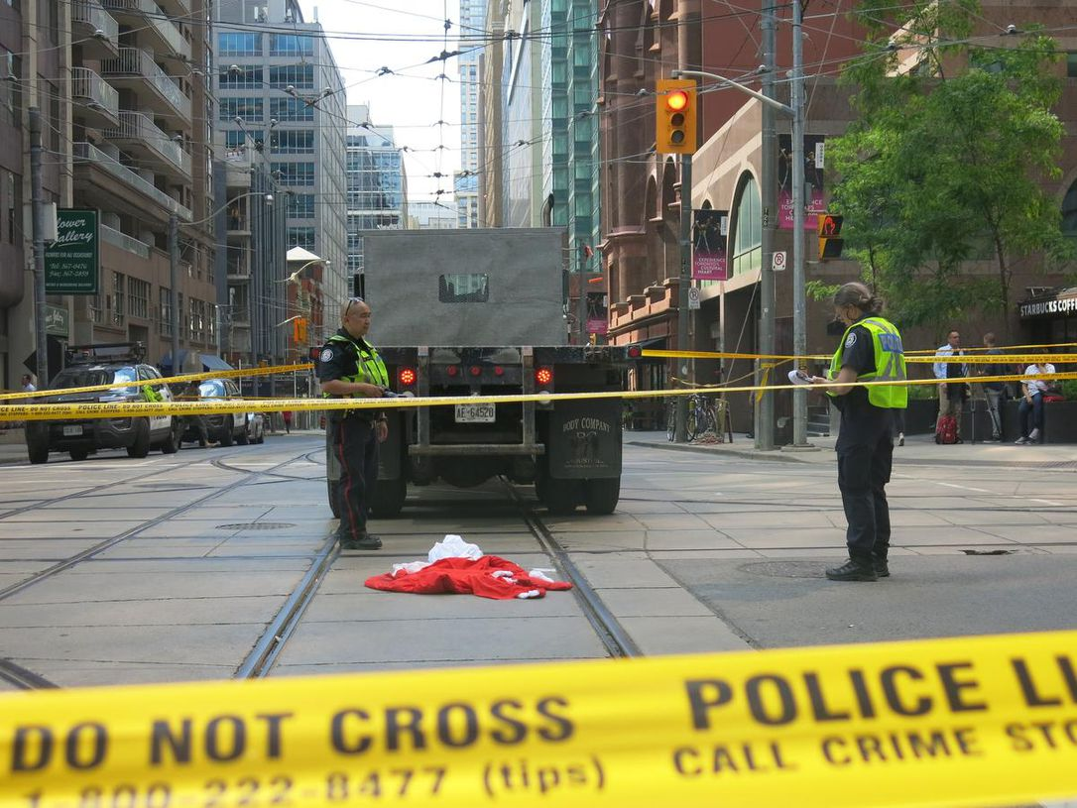
Driving Safely Near Pedestrians and Bicyclists
Manage the risk
When you are turning, you may have to wait for a gap in traffic. While you are watching for that gap, people may have moved into your intended path.
Make sure that you shoulder check before turning. Pedestrians and bikes may be in your blind spot.
Steer and brake smoothly if you need to avoid someone. Jerking the steering wheel or slamming the brakes will only make matters worse if you lose control.
Look behind you before you back up!

Slide 12
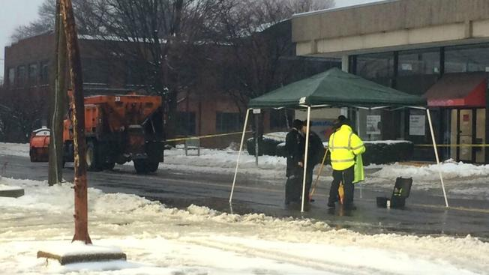
Applying What We Know
January 2015: Connecticut
A runner died after being struck by a snow plow in Connecticut, according to police.
A town resident was jogging along the road when a plow truck struck him. The resident was transported to the hospital, where he was pronounced dead.
The road was slushy and icy, and fog limited visibility at the time of the incident. It is believed that the resident came out into the travel lane to avoid some of the snow and ice that was built up in the road, at which point he entered the travel path of the plow.
What contributed to this crash?
What could the driver of the plow have done to reduce the chance of a crash?

Slide 13
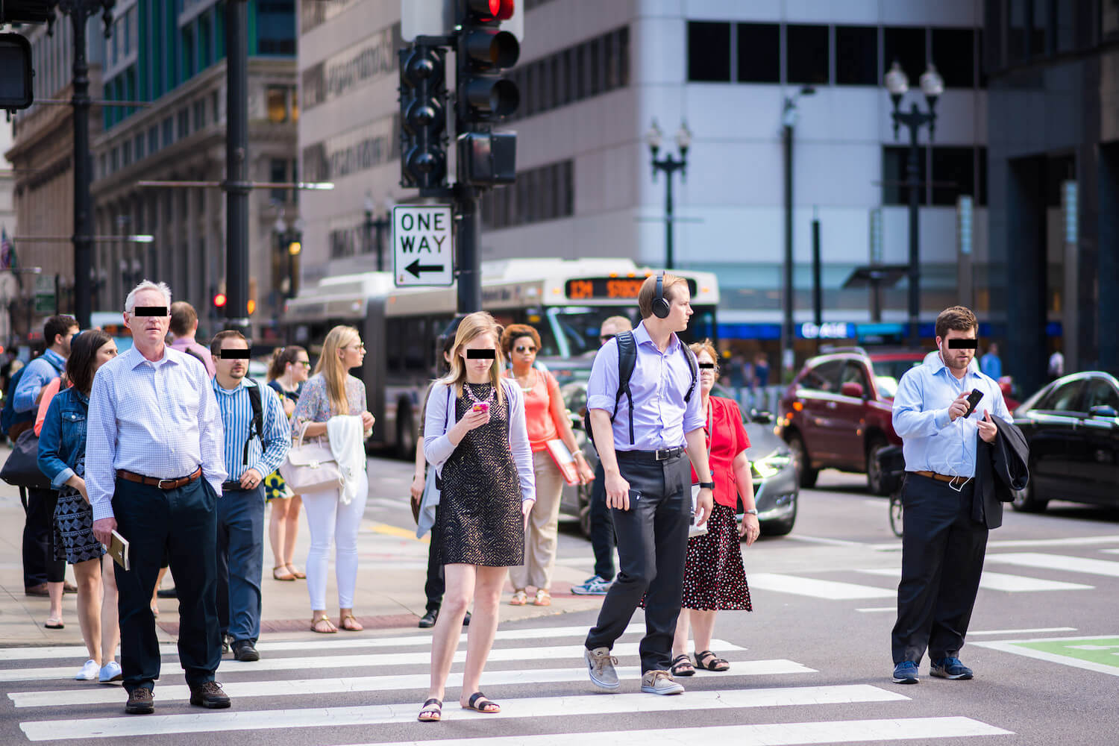
Let ‘Em Walk, Let ‘Em Live: Avoiding Conflicts With Pedestrians
Always slow down when passing pedestrians, especially children – they may not realize how long it takes for a truck to stop.
Once you see a pedestrian, anticipate and predict what they MAY do, and be prepared to respond as needed.
Don't assume that pedestrians see you or that they will act predictably. They may be physically or mentally impaired, or distracted by headphones, cellphones, etc.
Watch out for “hidden pedestrians” behind snow banks and other visual obstacles – especially children and people using wheelchairs and scooters.
Notes:
You can see some distractions in this picture: cell phones, headphones…

Slide 14
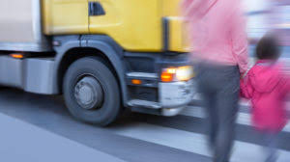
Avoiding Conflicts With Pedestrians
Be particularly attentive at night. Many pedestrians unwisely choose dark clothing that makes them difficult to see.
If you are able, make eye contact with pedestrians.
Be careful near bus stops or taxi stands – passengers might suddenly decide to cross the road.
Be on the lookout for small children, especially around schools and in neighborhoods where children are active.

Slide 15
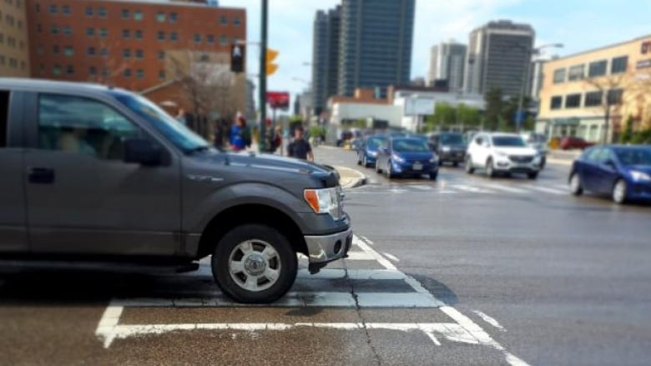
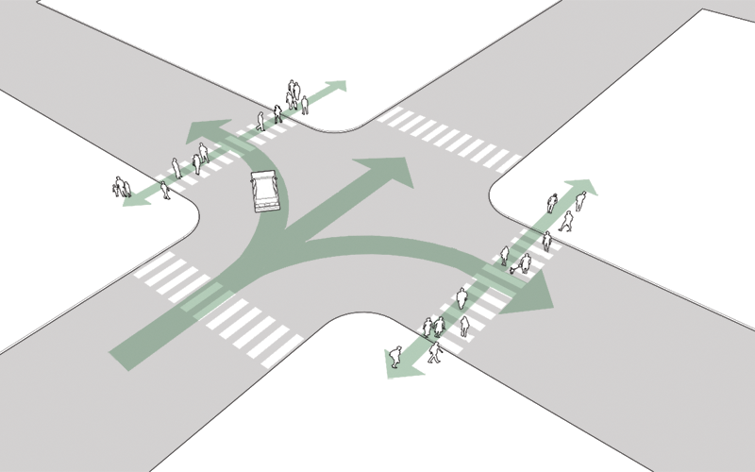
Crosswalk Tips
When you stop for a pedestrian in a crosswalk, stop well back so that drivers in the other lanes can also see the pedestrian in time to stop.
Don’t block the crosswalk when waiting for the light or to make a turn.
Never pass a car stopped at a crosswalk. Cars may be stopped to allow a pedestrian to cross.
Yield to pedestrians when turning if they have the “walk” sign.
Concurrent phasing
Notes:
Stopping far back also gives you a safety cushion in case you are rear-ended and pushed forward.

Slide 16
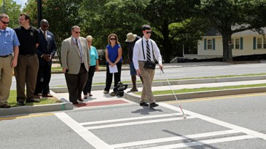
Crosswalk Tips
When you are stopped, watch for vehicles coming from behind you in other lanes that may not see the pedestrian. Honk your horn to alert the pedestrian if you think that the other driver isn’t stopping.
If a pedestrian is blind (using a white cane or walking with a guide dog), stay stopped until they are safely off of the road.
Don’t stop mid-block to invite pedestrians to cross. Other drivers don’t expect this and may either not stop for the pedestrian or hit you from behind.

Slide 17
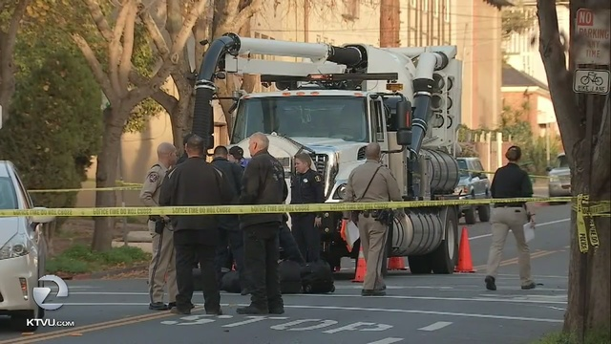
Applying What We Know
January 2018: California
A city employee was driving a large sewage maintenance truck that struck a woman who was crossing the street in a crosswalk.
As source said the narrow, often congested streets may have made it difficult to see for both the driver and the pedestrian.
The victim was pronounced dead at the scene.
Witnesses told investigators that the vehicle was going at about 15 mph. The driver of the vehicle is cooperating with investigators. They say there is no indication the driver broke the law.
What contributed to this crash?
What could the driver of the truck have done to reduce the chance of a crash?

Slide 18
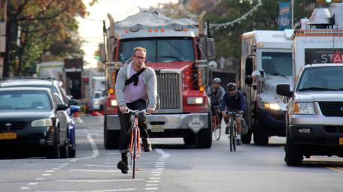
Two Wheels, Same Road: Driving Safely Around Bicyclists
Like drivers, cyclists must also follow the regulations for road users.
They are sometimes not permitted to ride on the sidewalks and are required to use the roadway.
Be prepared for cyclists to take the lane, it’s their right if they need it, as in cases where the shoulder is hazardous or the cyclist is taking a left.
Here are some tips for interacting with bicyclists on the road…
Notes:
Bicyclists can pose unique challenges to drivers. Dealing with cyclists can be frustrating, particularly if they are slow and in your lane where you don't have room to pass. Cyclists have different skill levels and capabilities and a different attitude towards traffic. They don't always use hand signals to communicate intent. While cyclists are required (like other road users) to signal, they sometimes need to keep their hands on the handle bars for safe steering and to control the brakes. This hinders their ability to use hand signals to communicate intents such as a left or right turn. Being aware of a cyclist's bike lane position will help a driver anticipate the cyclist's next movement.

Slide 19
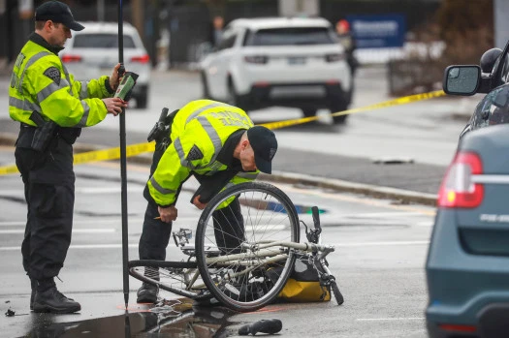
Driving Safely Around Bicyclists
Manage your space effectively and don't crowd cyclists particularly as you pass (remember to give 3 feet!)
The best plan is to wait until you can move way over into the other lane and not pass closely or squeeze them towards the curb or ditch. Be patient, wait to pass until it is safe.
Do not honk your horn, this could startle the cyclist and cause erratic behavior.
Always check your blind spot for cyclists. Be aware of cyclists approaching and passing your truck at intersections – they do not know they are in your blind spot.
If you have a trailer, they might not know it will not follow behind the truck on a turn.
Notes:
One small wobble or bump can send them right into your path. New riders are focused on controlling the bike and are easily startled by closely passing cars. This can cause them to jerk the handlebars and lose control.
At the end of the day, it’s all about sharing the road. Remember, bicyclists are people too, and they have just as much right to be on the road as cars. Be patient and stay alert, and we’ll all get home safely.

Slide 20
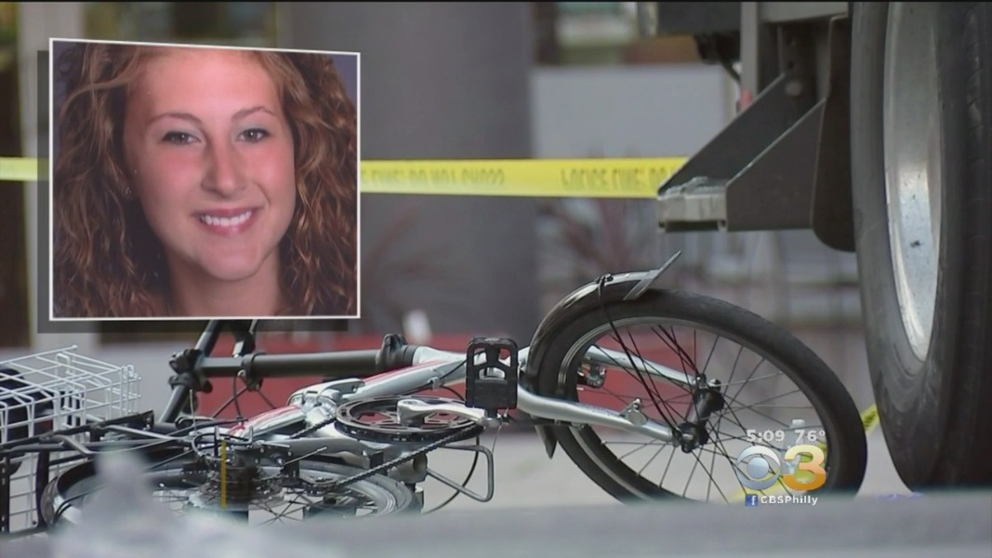
Applying What We Know
November 2017: Pennsylvania
Philadelphia police have identified the bicyclist who was killed when she was hit by a trash truck in Center City.
The victim is a 24-year-old Emily Fredricks. Fredricks was struck by a garbage truck turning right during an early morning commute on Nov. 28.
Investigators say the victim was lawfully traveling in the bike lane when she was struck. Officials say the driver was wearing earbuds and looking down at paperwork when he struck Fredricks.
“The internal cab video that we have showed, he didn’t check the mirrors immediately before the turn or even during the turn — he actually glanced down at a piece of paper or documents on a console, that was one. Two, he didn’t use his turn signal. Three, he didn’t yield to the bike lane that was alongside of him on the right hand side,” explained a Homicide Unit supervisor.
Credit: CBS3
What contributed to this crash?
What could the driver of the truck have done to reduce the chance of a crash?

Slide 21
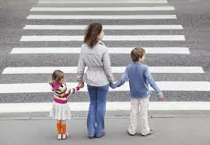
Walk This Way: Keep Yourself and Your Family Safe
The quick and dirty:
Teach your kids pedestrian safety from a young age and be a good example for them.
Use the crosswalk. If there is no crosswalk, yield to vehicles.
Look both ways before crossing.
If sidewalks are not available, walk on the left (facing traffic) along the left shoulder as far as possible.
Wear light colored or reflective clothing or use lights when walking or biking at dusk or night.
When cycling, wear a helmet, ride on the right with traffic, signal turns, and obey all traffic signals including red lights and stop signs.
If you work near moving vehicles of any type on or off the highway, wear your Personal Protective Equipment (PPE) and avoid turning your back on moving vehicles.
Notes:
We should practice what we preach. Safe drivers can give excellent instructions to their families and friends on how to be safe pedestrians and cyclists. Think about those situations when you just missed an accident, and then turn it into a lesson, instructing others not to put themselves in a similar situation.

Slide 22
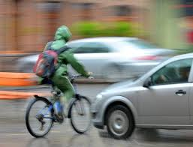
Practical Challenge:
This week, look for pedestrians and bicyclists and make sure that you yield when required to.
Notice how many close calls there are between vehicles and pedestrians/cyclists and make sure that you are not one of them.

Slide 23
Questions?
Special thanks to Thomas J. Roy, P.E., Director of Public Works, Town of Simsbury and George Tammaro,
Risk Management Services Manager, Connecticut Interlocal Risk Management Agency.
www.WatchForMeCT.org
Amy Watkins, MPH
Program Coordinator, Watch for Me CT
Connecticut Injury Prevention Center, Connecticut Children's Medical Center
860.837.5344
awatkins01@connecticutchildrens.org

